Slide 1

All pairs shortest path
We’ve learnt about Dijkstra’s and the Bellman-Ford algorithms which allows us to calculate the shortest distance from a node to all other (connected) nodes in a graph.
But what about if we wanted to know the shortest distance for all pairs of nodes….

Slide 2
Bellman-Ford Time Complexity
.
.
.
for i from T to length(allNodes(G))-T
foreach edge e in allEdges(G)
d(endNode(e)) := min(d(endNode(e)), d(startNode(e)+w(e)))
end
end
.
.
.

Slide 3

Bellman-Ford Time Complexity
.
.
.
for i from T to length(allNodes(G))-T
foreach edge e in allEdges(G)
d(endNode(e)) := min(d(endNode(e)), d(startNode(e)+w(e)))
end
end
.
.
.
this is size n

Slide 4
Bellman-Ford Time Complexity
.
.
.
for i from T to length(allNodes(G))-T
foreach edge e in allEdges(G)
d(endNode(e)) := min(d(endNode(e)), d(startNode(e)+w(e)))
end
end
.
.
.
this is size n
2
this is size n
think about a complete graph, each node will have n-T connections so the total number of connections will be
n(n-T)
2

Slide 5
Bellman-Ford Time Complexity
.
.
.
for i from T to length(allNodes(G))-T
foreach edge e in allEdges(G)
d(endNode(e)) := min(d(endNode(e)), d(startNode(e)+w(e)))
end
end
.
.
.
3
this is size n
O(n )
2
this is size n
think about a complete graph, each node will have n-T connections so the total number of connections will be
n(n-T)
2

Slide 6
All pairs shortest path
So if we use Bellman-Ford to calculate all the pairs of shortest paths, we have to do this n times…
meaning the time complexity will be O(n )
4

Slide 7
Warshall’s Algorithm for Transitive Closure
What is transitive closure?
Transitive → if a < b and b < c then we can say that a < c.
in terms of a graph, if a is connected to b and b is connected to c
then we can say that a is connected to c
Closure → only do operations that satisfy a certain property
in the graph case, we only add edges that represent existing paths
Informally, the transitive closure gives you the set of all places you can get to from any starting place.

Slide 8

Warshall’s Algorithm for Transitive Closure
n = |V| t⁽⁰⁾ = the adjacency matrix for G // there is always an empty path from a vertex to itself, // make sure the adjacency matrix reflects this for i in T..n do t⁽⁰⁾[i,i] = True end for // step through the t^{(k)}'s for k in T..n do for i in T..n do for j in T..n do t^{(k)}[i,j] = t^{(k-T)}[i,j] OR (t^{(k-T)}[i,k] AND t^{(k-T)}[k,j]) end for end for end for return t^{(n)}

Slide 9
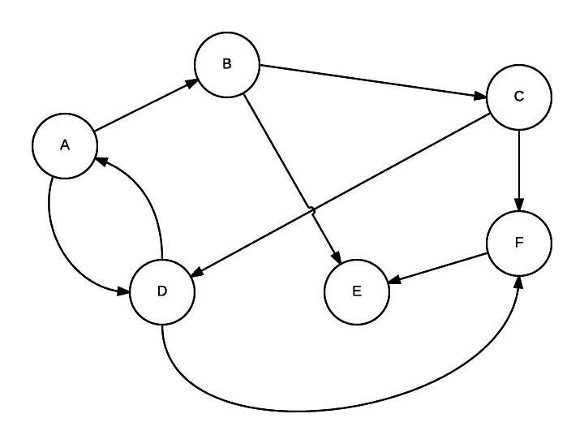
To
 | A | B | C | D | E | F
A | T
B |  | T
C |  |  | T
D |  |  |  | T
E |  |  |  |  | T
F |  |  |  |  |  | T
From
Notes:
O(n^3)

Slide 10
To
 | A | B | C | D | E | F
A | T | T |  | T
B |  | T | T |  | T
C |  |  | T | T |  | T
D | T |  |  | T |  | T
E |  |  |  |  | T
F |  |  |  |  | T | T
From
Notes:
O(n^3)

Slide 11
K = 0 (A)
To
 | A | B | C | D | E | F
A | T | T |  | T
B |  | T | T |  | T
C |  |  | T | T |  | T
D | T | T |  | T |  | T
E |  |  |  |  | T
F |  |  |  |  | T | T
From
Notes:
O(n^3)

Slide 12
K = 1 (B)
To
 | A | B | C | D | E | F
A | T | T | T | T | T
B |  | T | T |  | T
C |  |  | T | T |  | T
D | T | T | T | T | T | T
E |  |  |  |  | T
F |  |  |  |  | T | T
From
Notes:
O(n^3)

Slide 13
K = 2 (C)
To
 | A | B | C | D | E | F
A | T | T | T | T | T | T
B |  | T | T | T | T | T
C |  |  | T | T |  | T
D | T | T | T | T | T | T
E |  |  |  |  | T
F |  |  |  |  | T | T
From
Notes:
O(n^3)

Slide 14
K = 3 (D)
To
 | A | B | C | D | E | F
A | T | T | T | T | T | T
B | T | T | T | T | T | T
C | T | T | T | T | T | T
D | T | T | T | T | T | T
E |  |  |  |  | T
F |  |  |  |  | T | T
From
Notes:
O(n^3)

Slide 15
K = 4 (E)
To
 | A | B | C | D | E | F
A | T | T | T | T | T | T
B | T | T | T | T | T | T
C | T | T | T | T | T | T
D | T | T | T | T | T | T
E |  |  |  |  | T
F |  |  |  |  | T | T
From
Notes:
O(n^3)

Slide 16
K = 5 (F)
To
 | A | B | C | D | E | F
A | T | T | T | T | T | T
B | T | T | T | T | T | T
C | T | T | T | T | T | T
D | T | T | T | T | T | T
E |  |  |  |  | T
F |  |  |  |  | T | T
From
Notes:
O(n^3)

Slide 17

Why is this useful?
With a slight modification to Warshall’s Transitive Closure
Algorithm, we can solve this problem in time
3
O(n )

Slide 18
Floyd-Warshall Algorithm
n = |V| t⁽⁰⁾ = the weight matrix for edges of G, with infinity if there is no edge // length of a path from vertex to itself is zero for i in T..n do t⁽⁰⁾[i,i] = 0 end for // step through the t^{(k)}'s for k in T..n do for i in T..n do for j in T..n do t^{(k)}[i,j] = min (t^{(k-T)}[i,j], t^{(k-T)}[i,k] + t^{(k-T)}[k,j]) end for end for end for return t^{(n)}

Slide 19
Floyd-Warshall Algorithm
n = |V| t⁽⁰⁾ = the weight matrix for edges of G, with infinity if there is no edge // length of a path from vertex to itself is zero for i in T..n do t⁽⁰⁾[i,i] = 0 end for // step through the t^{(k)}'s for k in T..n do for i in T..n do for j in T..n do t^{(k)}[i,j] = min (t^{(k-T)}[i,j], t^{(k-T)}[i,k] + t^{(k-T)}[k,j]) end for end for end for return t^{(n)}
Relaxing a connection

Slide 20
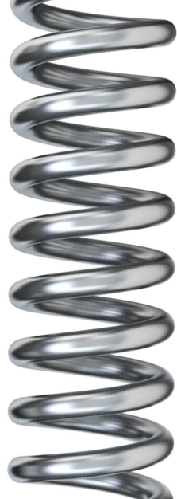
Floyd-Warshall Algorithm
n = |V| t⁽⁰⁾ = the weight matrix for edges of G, with infinity if there is no edge // length of a path from vertex to itself is zero for i in T..n do t⁽⁰⁾[i,i] = 0 end for // step through the t^{(k)}'s for k in T..n do for i in T..n do for j in T..n do t^{(k)}[i,j] = min (t^{(k-T)}[i,j], t^{(k-T)}[i,k] + t^{(k-T)}[k,j]) end for end for end for return t^{(n)}
Relaxing a connection

Slide 21
Floyd-Warshall Algorithm
n = |V| t⁽⁰⁾ = the weight matrix for edges of G, with infinity if there is no edge // length of a path from vertex to itself is zero for i in T..n do t⁽⁰⁾[i,i] = 0 end for // step through the t^{(k)}'s for k in T..n do for i in T..n do for j in T..n do t^{(k)}[i,j] = min (t^{(k-T)}[i,j], t^{(k-T)}[i,k] + t^{(k-T)}[k,j]) end for end for end for return t^{(n)}
Relaxing a connection

Slide 22

To
 | A | B | C | D | E | F
A | 0
B |  | 0
C |  |  | 0
D |  |  |  | 0
E |  |  |  |  | 0
F |  |  |  |  |  | 0
From
Notes:
O(n^3)

Slide 23
To
 | A | B | C | D | E | F
A | 0 | 4 |  | 3
B |  | 0 | 5 |  | 6
C |  |  | 0 | 8 |  | 1
D | 2 |  |  | 0 |  | 5
E |  |  |  |  | 0
F |  |  |  |  | 2 | 0
From
Notes:
O(n^3)

Slide 24
K = 0 (A)
To
 | A | B | C | D | E | F
A | 0 | 4 |  | 3
B |  | 0 | 5 |  | 6
C |  |  | 0 | 8 |  | 1
D | 2 | 6 |  | 0 |  | 5
E |  |  |  |  | 0
F |  |  |  |  | 2 | 0
From
Notes:
O(n^3)

Slide 25
K = 1 (B)
To
 | A | B | C | D | E | F
A | 0 | 4 | 9 | 3 | 10
B |  | 0 | 5 |  | 6
C |  |  | 0 | 8 |  | 1
D | 2 | 6 | 11 | 0 | 12 | 5
E |  |  |  |  | 0
F |  |  |  |  | 2 | 0
From
Notes:
O(n^3)

Slide 26
K = 2 (C)
To
 | A | B | C | D | E | F
A | 0 | 4 | 9 | 3 | 10 | 10
B |  | 0 | 5 | 13 | 6 | 6
C |  |  | 0 | 8 |  | 1
D | 2 | 6 | 11 | 0 | 12 | 5
E |  |  |  |  | 0
F |  |  |  |  | 2 | 0
From
Notes:
O(n^3)

Slide 27
K = 3 (D)
To
 | A | B | C | D | E | F
A | 0 | 4 | 9 | 3 | 10 | 10
B | 15 | 0 | 5 | 13 | 6 | 6
C | 10 | 14 | 0 | 8 | 20 | 1
D | 2 | 6 | 11 | 0 | 12 | 5
E |  |  |  |  | 0
F |  |  |  |  | 2 | 0
From
Notes:
O(n^3)

Slide 28
K = 4 (E)
To
 | A | B | C | D | E | F
A | 0 | 4 | 9 | 3 | 10 | 10
B | 15 | 0 | 5 | 13 | 6 | 6
C | 10 | 14 | 0 | 8 | 20 | 1
D | 2 | 6 | 11 | 0 | 12 | 5
E |  |  |  |  | 0
F |  |  |  |  | 2 | 0
From
Notes:
O(n^3)

Slide 29
K = 5 (F)
To
 | A | B | C | D | E | F
A | 0 | 4 | 9 | 3 | 10 | 10
B | 15 | 0 | 5 | 13 | 6 | 6
C | 10 | 14 | 0 | 8 | 3 | 1
D | 2 | 6 | 11 | 0 | 7 | 5
E |  |  |  |  | 0
F |  |  |  |  | 2 | 0
From
Notes:
O(n^3)

